Slide 1

Data SAIL Club
Spring 2026

Slide 2
Agenda
Club structure
Activities and Conferences
Discord and Feedback

Slide 3

Club Structure

Slide 4
Organization
Club President: Pol Monné
Club Vice President: Pau Casé
Management (Treasurer & Project Manager): Wesley Keever
Graduate Support: Ben Escobar

Slide 5
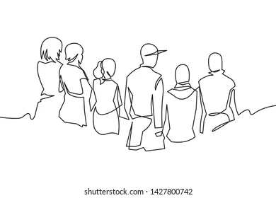
Members
Who are you?

Slide 6
DEMO 1: Beat the AI
AI and ML learning are concepts that existed way before ChatGPT!
We will work on the following activity with Akinator (reflect on what's happening under the hood)
Try to think about:
Information Gain
What kind of model is running?
How does the model improve over time?
https://en.akinator.com/theme-selection

Slide 7

Activities and Conferences

Slide 8

Argone National Laboratory Tour
What is it? Multidisciplinary science and engineering research center.
Where is it? Lemont, Illinois, USA
When is it? TBD

Slide 9
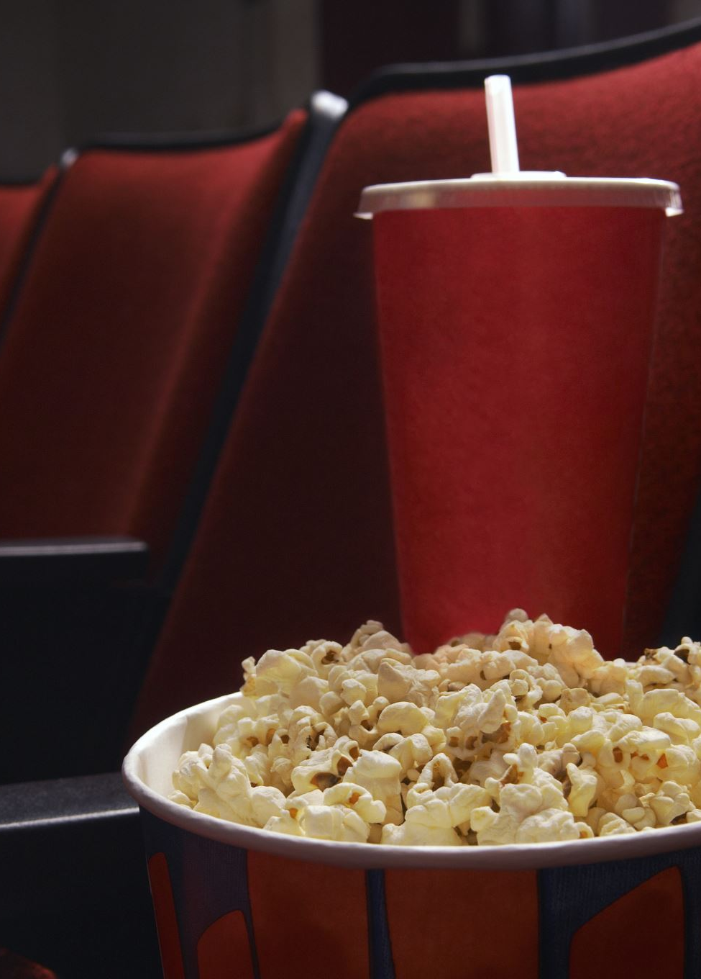
Movie Nights
No movies selected yet, we are open to suggestions.
With a huge screen at Memorial Hall
Drinks and apetizers will be available
One or two sessions during the semester

Slide 10

PyCon US 2026
What is it? The largest Python conference in the world
Where is it? Long Beach, California, USA
When is it? May 13 - May 19, 2026
The travel grant deadline is February 25th
https://us.pycon.org/2026/

Slide 11

SDSS 2026
What is it? Symposium on Data Science & Statistics.
Where is it? Milwaukee, Wisconsin, USA
When is it? April 28, 2026 – May 1, 2026
There is a registration fee ($265 for students)
https://ww2.amstat.org/meetings/sdss/2026/registration.cfm

Slide 12
DEMO 2: Train an AI
Google Teachable Machine
https://teachablemachine.withgoogle.com/train/image
How did the model correctly predict classes?

Slide 13

Discord and Feedback

Slide 14

Discord
Main source of communication
If you can not attend one meeting, just ask for it and we will make sure you can join online!
Introduce yourself!

Slide 15
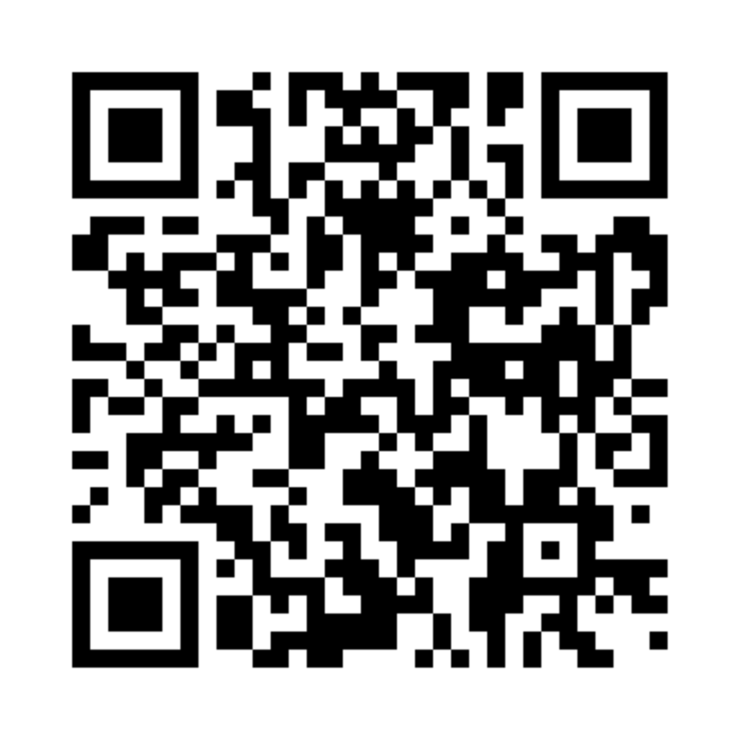
Feedback
We need to know your interests to make this semester great!

